Slide 1

SE401 - Software Quality Assurance and Testing
Web Testing

Slide 2
Outline
Web-site vs. Web Application
Testing Web Applications
Web Testing Types
Test Automation

Slide 3
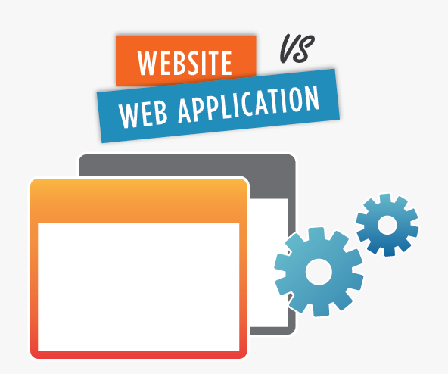
Website vs. Web Application
A website is a collection of related web pages, including multimedia content, typically identified with a common domain name, and published on at least one web server. Notable examples are wikipedia.org.
So .. A website is informational

Slide 4
Website vs. Web Application
A web application: is a client–server computer program which the client (including the user interface and client-side logic) runs in a web browser. Common web applications include webmail, online retail sales, and online auction.
So .. a web application is interactive

Slide 5
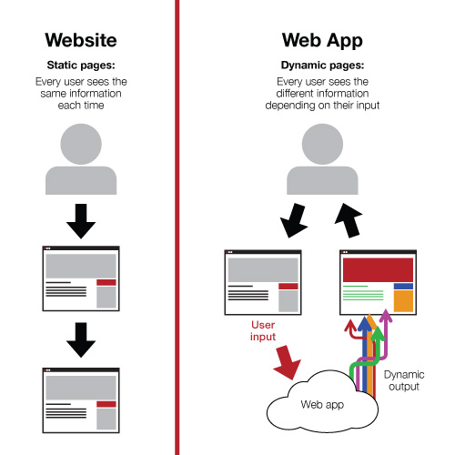
So ..

Slide 6
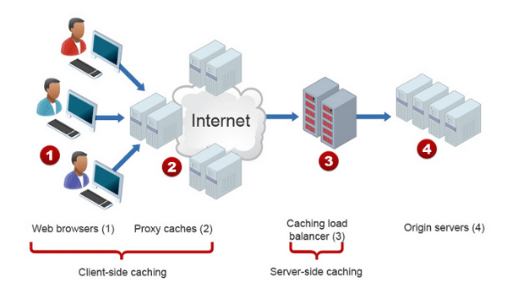
What is Web Testing
Web testing is a software testing practice to test the websites or web applications for potential bugs.
A web-based system needs to be checked completely from end-to-end before it goes live for end users.

Slide 7
What is Web Testing
It is performed before making the web application alive.
By performing web testing, we can make sure that the website or web application is functioning properly and can be accepted by real-time users.

Slide 8

Why Web Testing is Challenging?
Web based systems and applications interoperate with many different:
Operating systems
Browsers
Hardware platforms
Communications protocols
The search for errors represents a significant challenge
New technologies make web applications rich, but they become more difficult to test.

Slide 9
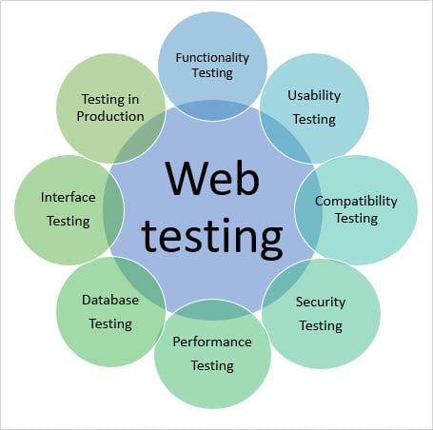
Web Testing Types
Some or all the following testing types may be performed depending on the web testing requirements:
1. Functionality Testing
2. Usability testing
3. Interface testing
4. Compatibility testing
5. Performance testing
6. Security testing

Slide 10
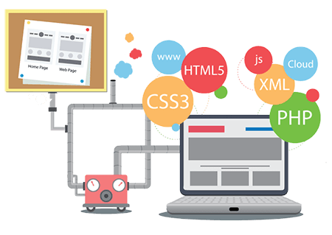
1. Functionality Testing
Testing the features and operational behavior of a web application to ensure they correspond to its specifications.
Test for – all the links in web pages, database connection, forms used for submitting or getting information from the user in the web pages, Cookie testing, and HTML and CSS files etc.

Slide 11
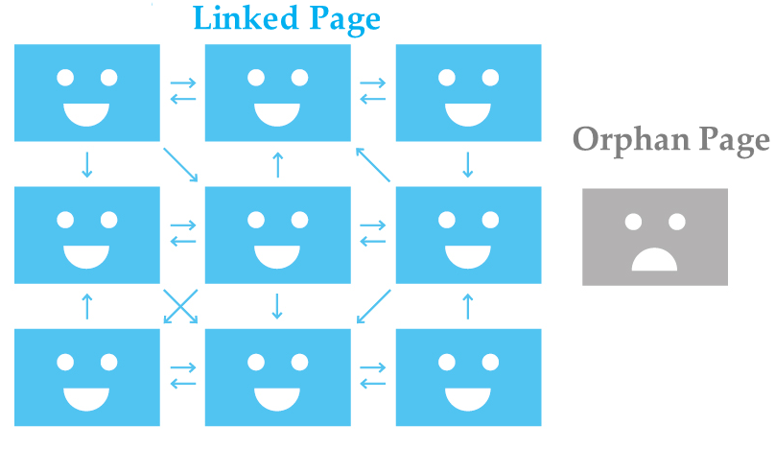
1. Functionality Testing
1.1 Check all the links:
Test the external links from all the pages to a specific domain under test.
Test all internal links between web application pages
Test links used to send email to admin or other users from web pages.
Test to check if there are any orphan pages.
Finally, link checking includes, check for broken links in all above-mentioned links.

Slide 12
1. Functionality Testing
1.2 Test forms on all pages: Forms are part of any website that is used for receiving information from users and to interact with them.
So what should be checked in these forms?
First, check all the validations on each field.
Check for default values of the fields.
Wrong inputs to the fields in the forms.

Slide 13
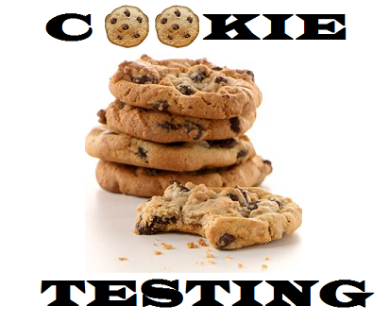
1. Functionality Testing
1.3 Test Cookies: cookies are small files that are stored on a user's computer. They hold data specific to a particular client and website, and can be accessed either by the web server or the client computer.
Test the application by enabling or disabling cookies in a browser
Test if cookies are encrypted before they are written to the user machine
Test if cookies are deleted when they are not needed anymore.

Slide 14
1. Functionality Testing
1.4 Test HTML and CSS:
Checking for syntax errors
Check if the site is crawlable by different search engines.
Readable color scheme and fonts
Standards compliance (i.e. such as W3C and ISO)

Slide 15
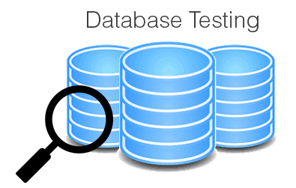
1. Functionality Testing
1.5 Database Testing:
Data validity testing: test if any errors are shown while executing queries
Data integrity testing: check for errors while you edit, delete, modify data in database
Check response time of queries.
Check if all the database queries are executing correctly, data is retrieved and updated correctly.
Check if data retrieved from database is shown accurately in the web application .

Slide 16
1. Functionality Testing
Examples of Functionality Test Scenarios:
Test all the mandatory fields should be validated.
Test the system should not display the error message for optional fields.
Test the numeric fields should not accept the alphabets and proper error message should display.
Test the pop-up message ("This field is limited to 500 characters") should display if the data reaches the maximum size of the field.
Test that a confirmation message should display for update and delete operations.
Test all input fields for special characters.
Test the functionality of the buttons available, … etc.

Slide 17
2. Usability Testing
Usability testing is the process by which the human-computer interaction characteristics of a system are measured, and weaknesses are identified for correction.
In usability testing:
Check if the application is user-friendly (general appearance and interaction)
Check the flow of the system and that it is easy to understand and learn by the user
Basically, system navigation and content are checked in usability testing

Slide 18
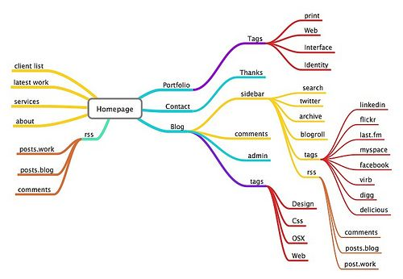
2. Usability Testing
2.1 Navigation:
Navigation means how a user surfs the web pages, different controls like buttons, boxes or how the user uses the links on the pages to surf different pages.
Menus, buttons or links to different pages on your site should be easily visible and consistent on all webpages
The web application should be easy to use and navigate

Slide 19
2. Usability Testing
2.2 Content:
Content should be logical and easy to understand. Check for spelling errors. Usage of dark colors annoys the users and should not be used in the site theme.
You can follow some standard colors that are used for web page and content building.
Content should be meaningful. All the anchor text links should be working properly. Images should be placed properly with proper sizes.
These are some of the basic important standards that should be followed in web development.

Slide 20
2. Usability Testing
Examples of Usability Test Scenarios:
All fonts should be same as per the requirements.
All the text should be properly aligned.
Tool tip text should be there for every field.
All the buttons should be in a standard format and size.
Home link should be there on every single page.
Confirmation message should be displayed for any kind of interaction.
Check the site on different resolutions (640 x 480, 600x800 etc.?)
Check the end user can run the system without frustration.
Scroll bar should appear only if required.
All fields and buttons should be accessible by keyboard shortcuts and the user should be able to perform all operations by using keyboard… etc.

Slide 21
3. Interface Testing
The main layers in a web application are:
Web server
Application server
Database server
Check if all interactions between these layers are executed properly
Interactions between different pages in the applications are also checked

Slide 22
4. Compatibility Testing
Compatibility testing is used to determine if your software is compatible with other elements of a system with which it should operate, e.g. Browsers, Operating Systems, or hardware.
The purpose of Compatibility testing is to evaluate how well software performs under different browsers, operating systems, hardware or software.

Slide 23
4. Compatibility Testing
Examples of Compatibility Test Scenarios:
Test the web application in different browsers (IE, Firefox, Chrome, Safari and Opera) and ensure the website is displaying properly.
Test the HTML version being used is compatible with appropriate browser versions.
Test the images display correctly in different browsers.
Test the fonts are usable in different browsers.
Test the java script code is usable in different browsers.
Test the Animated GIF's across different browsers.
Etc..

Slide 24
5. Security Testing
Security Testing is vital for web applications that store sensitive customer information like credit cards, ids, passwords, etc.
Testing activities will include:
Test unauthorized access to secure pages should not be permitted
Restricted files should not be downloadable without appropriate access
Check sessions are automatically killed after prolonged user inactivity
On use of SSL certificates, website should re-direct to encrypted SSL pages.

Slide 25
5. Security Testing
Examples of Security Test Scenarios:
Verify the web page which contains important data like password, credit card numbers, secret answers for security question etc should be submitted via HTTPS (SSL).
Verify the important information like password, credit card numbers etc should display in encrypted format.
Verify password rules are implemented on all authentication pages like Registration, forgot password, change password.
Verify if the user is logged out from the system or user session was expired, the user should not be able to navigate the site.
Verify the user account gets locked out if the user is entering the wrong password several times.
Verify the user roles and their rights. For Example The requestor should not be able to access the admin page.
Etc..

Slide 26
6. Performance Testing
This will ensure your site works under all loads. Testing activities will include but not limited to:
Website application response times at different connection speeds
Load test your web application to determine its behavior under normal and peak loads
Stress test your web site to determine its break point when pushed to beyond normal loads at peak time.
Test if a crash occurs due to peak load, how does the site recover from such an event

Slide 27
6. Performance Testing
Examples of Performance Test Scenarios:
To determine the performance, stability and scalability of an application under different load conditions.
To determine if the current architecture can support the application at peak user levels.
To determine which configuration provides the best performance level.
To identify application and infrastructure bottlenecks.
To determine if the new version of the software adversely had an impact on response time.
To evaluate product and/or hardware to determine if it can handle projected load volumes.
Etc..

Slide 28
Website Test Automation
Automation testing helps to relieve the bulk of tedious and repetitive human tasks.
With the right test automation framework or tool, QAs can automate repetitive browser actions like interacting with web elements or filling out long HTML forms.
Automating tests help teams save time and effort, get faster and accurate results, increase software efficiency, and focus on innovation.

Slide 29
Benefits of Website Test Automation
Faster feedback
Improved test efficiency
Reduced expenses
Reusability of test cases
Faster time to market

Slide 30
Selenium
Selenium is open source testing tool for web applications. Any web application can be testing on web browsers with this automation testing tool.
Selenium tool can test only web application, it is not useful for mobile or desktop applications.
Test scripts can be written in Java, Python, C#, PHP, Ruby, Perl & .Net
Tests can be carried out in Windows, Mac or Linux
Tests can be carried out using Mozilla Firefox, Internet Explorer, Google Chrome, Safari or Opera
It can be integrated with tools like JUnit for managing test cases and generating reports

Slide 31
Setup Selenium
Eclipse IDE (Users can use other IDEs too)
Selenium Client and language WebDiver bindings
Configuring Selenium WebDriver with Eclipse

Slide 32
Summary
Web-site vs. Web Application
Testing Web Applications
Web Testing Types
Test Automation

